Slide 1


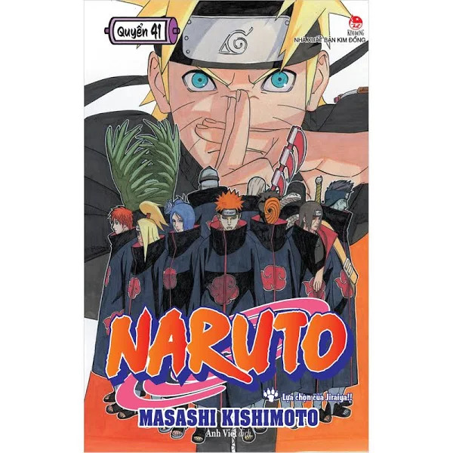
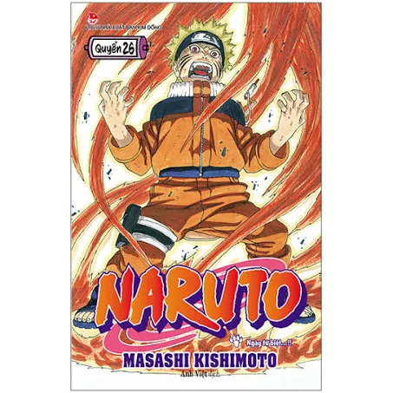
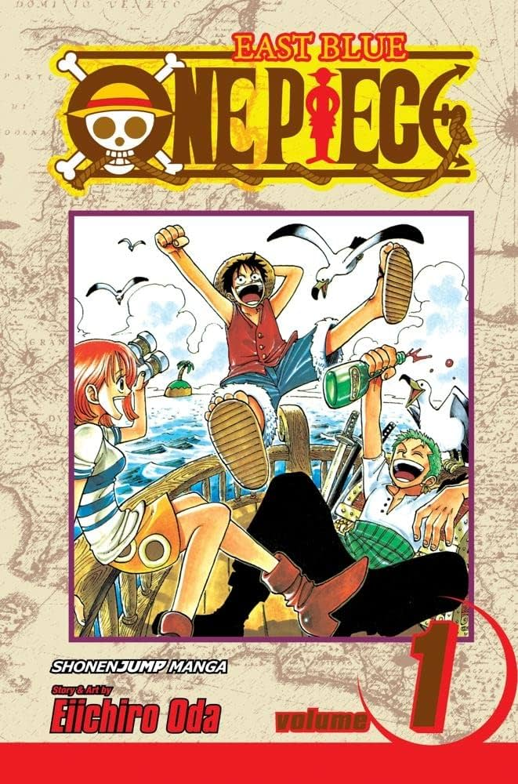
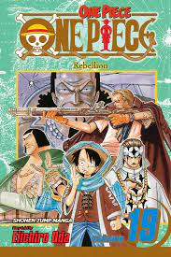
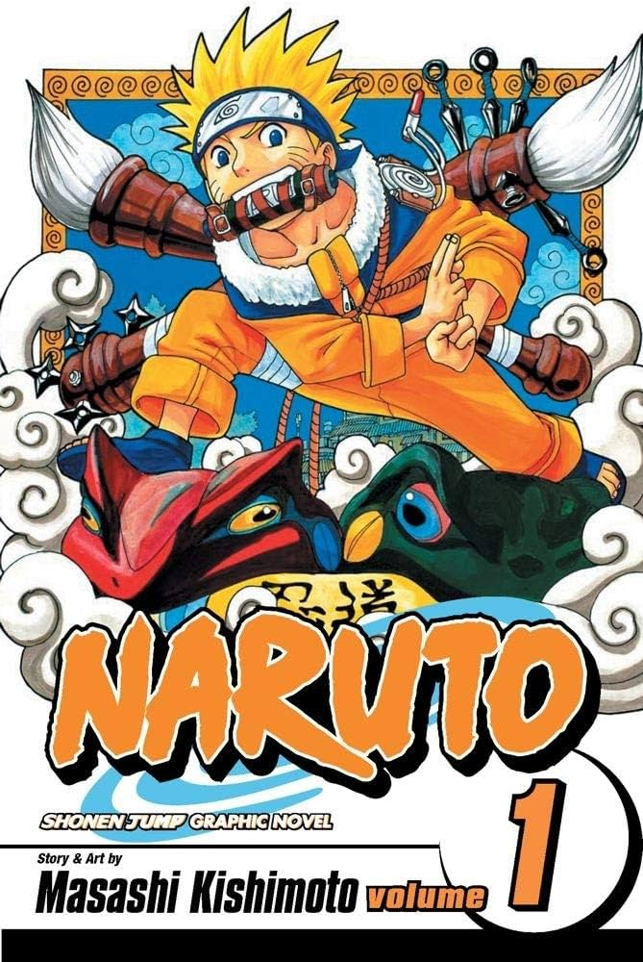
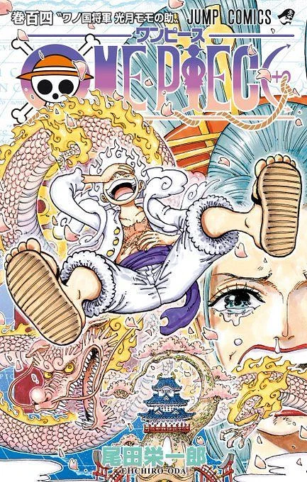
Manga world

Slide 2

漫画
01
Introduction

Slide 3
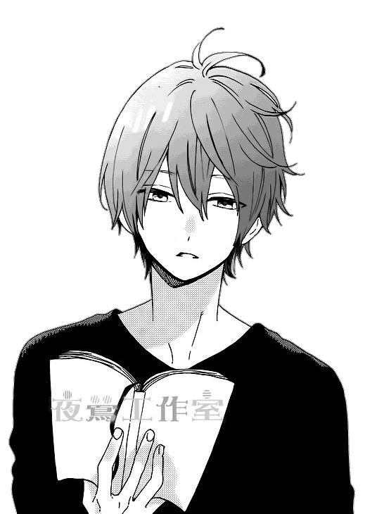

Introduction
With a long history deeply rooted in the rich Japanese art, manga are one of the most fascinating phenomena in Japan and the whole world.
Part of the “otaku” (“nerd”) culture, these comics have been a major player in the country’s publishing industry, creating a robust market, reaching millions of readers of all ages
Source Article: Widewalls

Slide 4
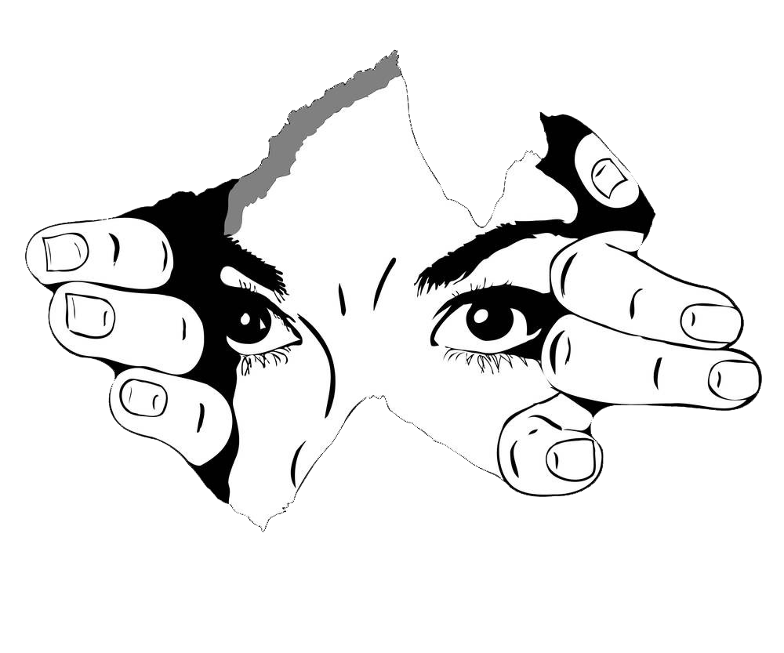
Introduction
Introduction
From history and teenage romance to futuristic science fiction and profound themes of life, manga became an important, almost inevitable aspect of Japan’s identity and they helped spread knowledge and understanding of it across the planet.
Source Article: Widewalls

Slide 5
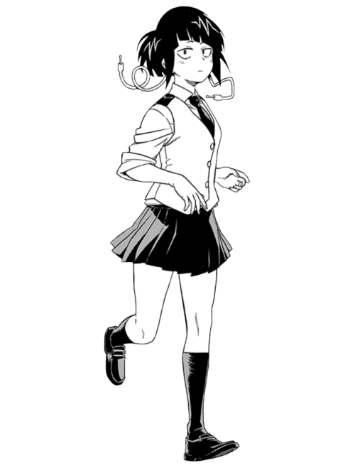
漫画
02
What is manga?
A Brief History

Slide 6
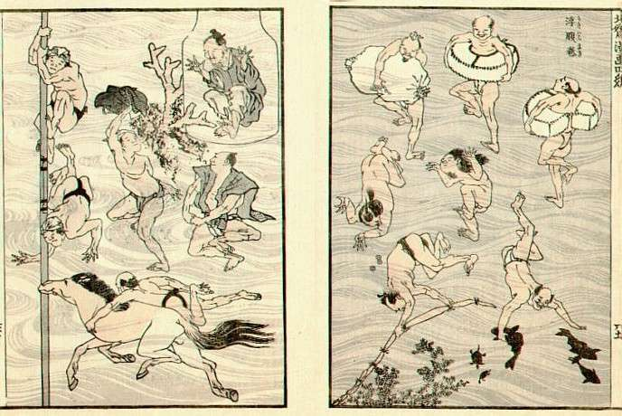
What is Manga? A Brief History
What many believed were the very first manga in Japan appeared in the 12th and 13th century, in a series of drawings like frogs and rabbits titled Choju-giga (Scrolls of Frolicking Animals) produced by several artists. In fact, their technique of drawing a characters’ legs to simulate running was adopted by many manga-ka (manga makers and comic book artists) working today.
During the Edo Period (1603-1867), another book of drawings, Toba Ehon, embedded the concept of manga, yet the term itself was first used in 1798, to describe the picture book Shiji no Yukikai (Four Seasons) by Santō Kyōden. In 1814, it showed up again, as the title of Aikawa Mina’s Manga hyakujo and the celebrated Hokusai Manga books of drawings by the famous ukiyo-e artist Hokusai.
Inside Katsushika Hokusai’s Manga books, said to be among the first examples of the comics form in history.
Image via harvardartmuseums.org
Source Article: Widewalls

Slide 7
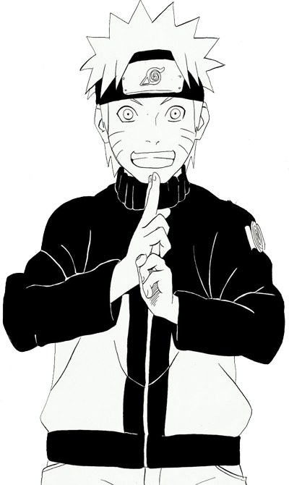
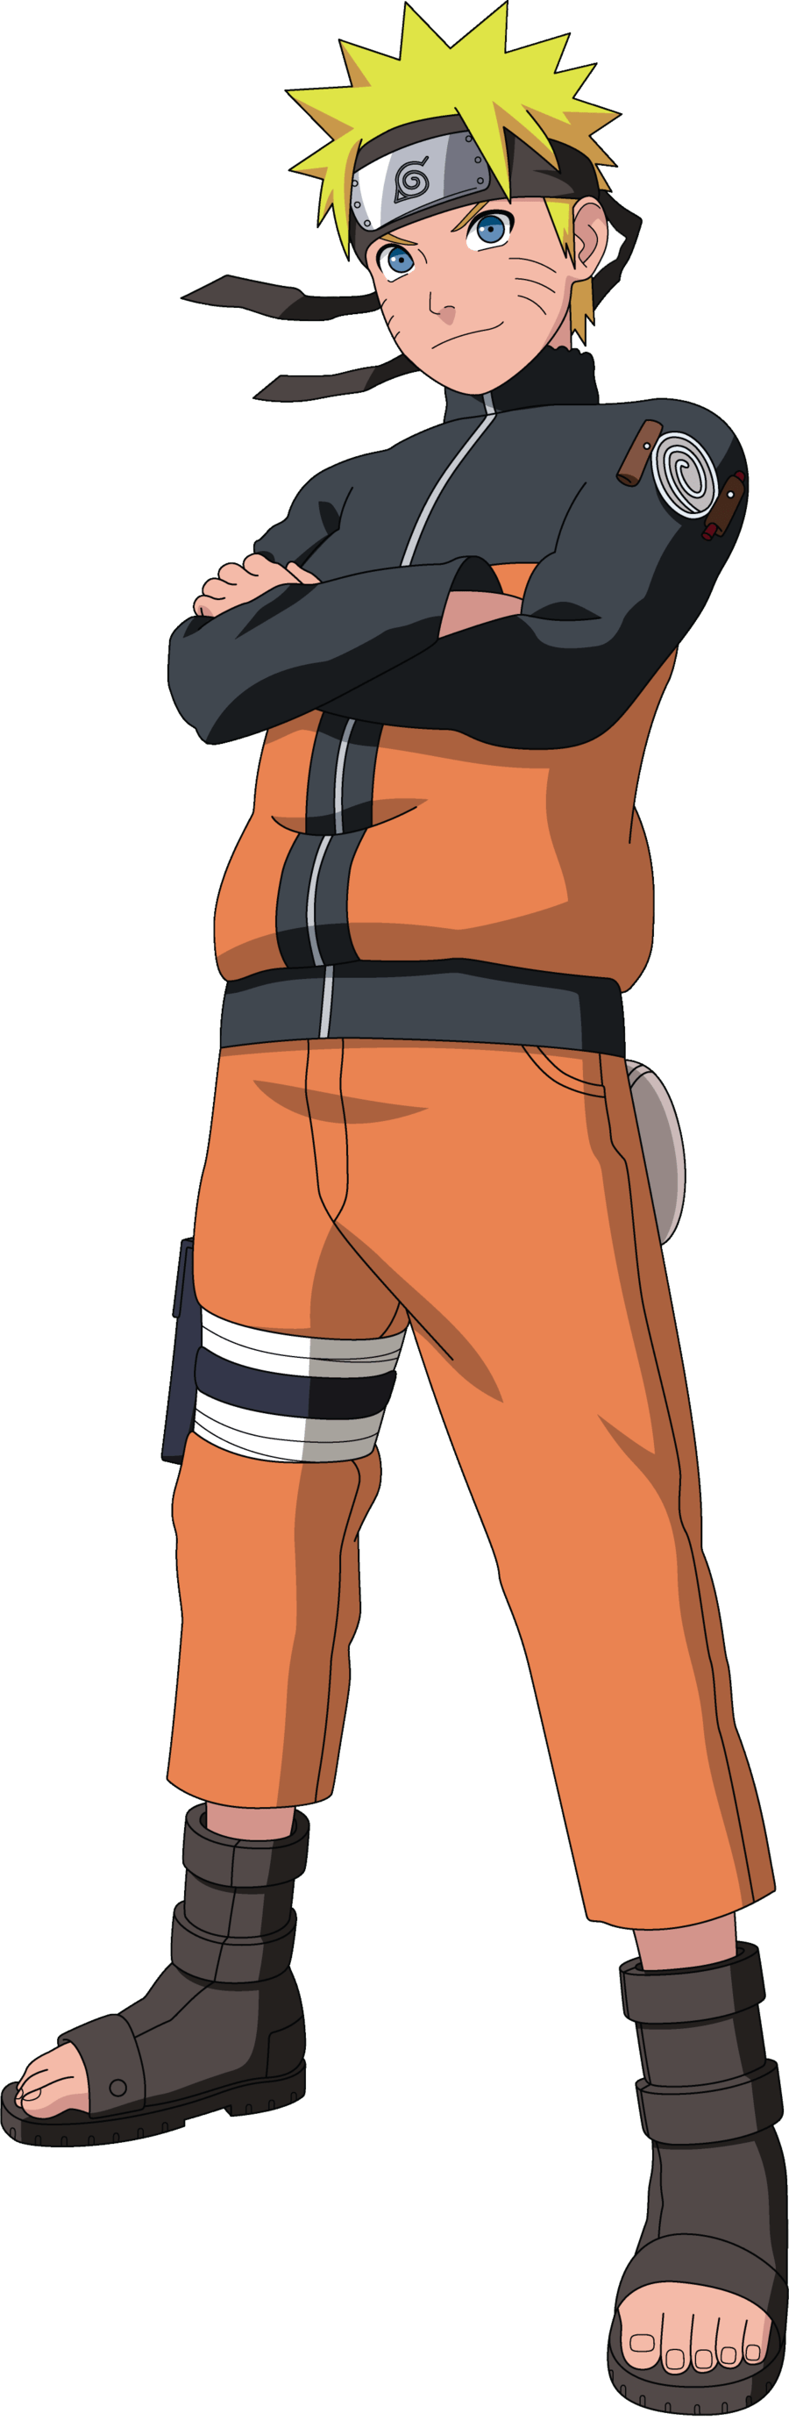
Manga vs Anime
In Japanese, the term “manga” can refer to all kinds of cartooning, comics and animation, as it is composed of two kanji - “man”, meaning “whimsical or impromptu” and “ga”, meaning “pictures”, together forming 漫画. This is why, historically speaking, there could be many early examples referring to the aesthetics and narratives used in modern-day manga.
In Japanese, the term “manga” can refer to all kinds of cartooning, comics and animation, as it is composed of two kanji - “man”, meaning “whimsical or impromptu” and “ga”, meaning “pictures”, together forming 漫画. This is why, historically speaking, there could be many early examples referring to the aesthetics and narratives used in modern-day manga. Outside Japan, “manga” is used to describe comics only while “anime” covers cartoons and animated comics of many kinds. Anime is usually, but not always, the animated version of manga.
Manga
Anime
Outside Japan, “manga” is used to describe comics only.
“Anime” covers cartoons and animated comics of many kinds. Anime is usually, but not always, the animated version of manga.
Source Article: Widewalls

Slide 8
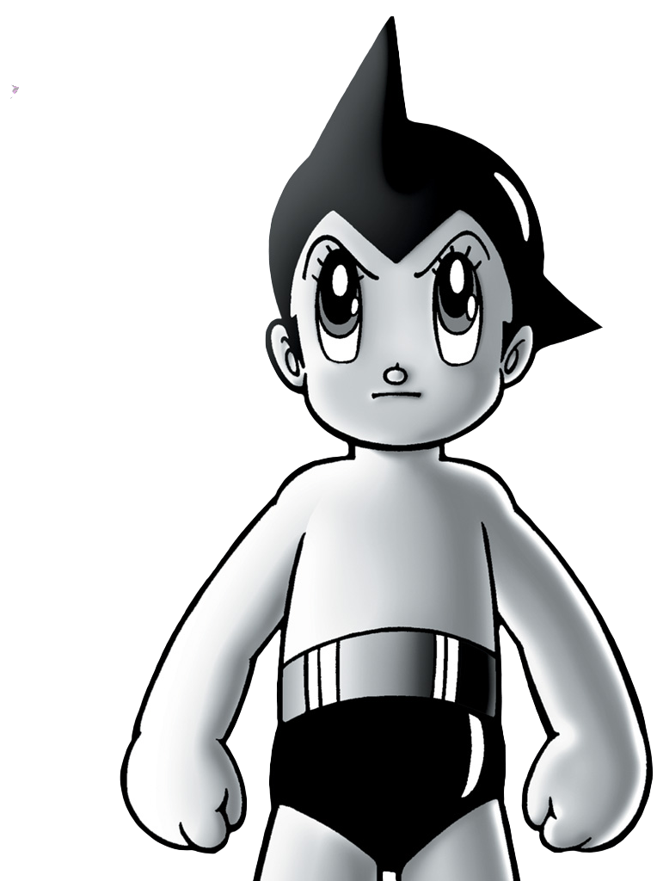
漫画
03
Manga in
US-Occupied Japan

Slide 9
Manga in US-Occupied Japan
Following World War II, Japan found itself under the occupation of the United States. This was an important event in the development of manga. The Americans brought their own comics and cartoons, such as Disney works, Mickey Mouse, Betty Boop and Bambi, to the country. The Japanese artists subsequently gave life to their own style, primarily within newspapers and magazines, and these then evolved into dedicated weekly and monthly comic magazines
Among the first and to date most successful manga artists, there were Osamu Tezuka, who created the famous Astro Boy, as well as Machiko Hasegawa, with his Sazae-san.
Inside Katsushika Hokusai’s Manga books, said to be among the first examples of the comics form in history.
Image via harvardartmuseums.org
Source Article: Widewalls

Slide 10
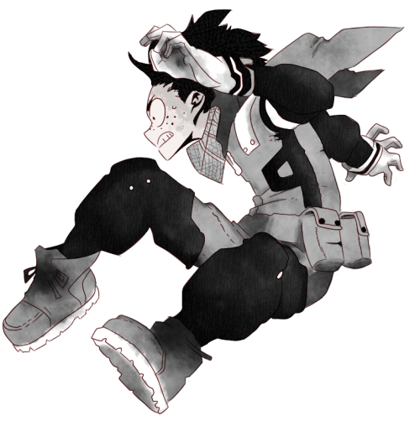
漫画
04
Types of
manga comics

Slide 11
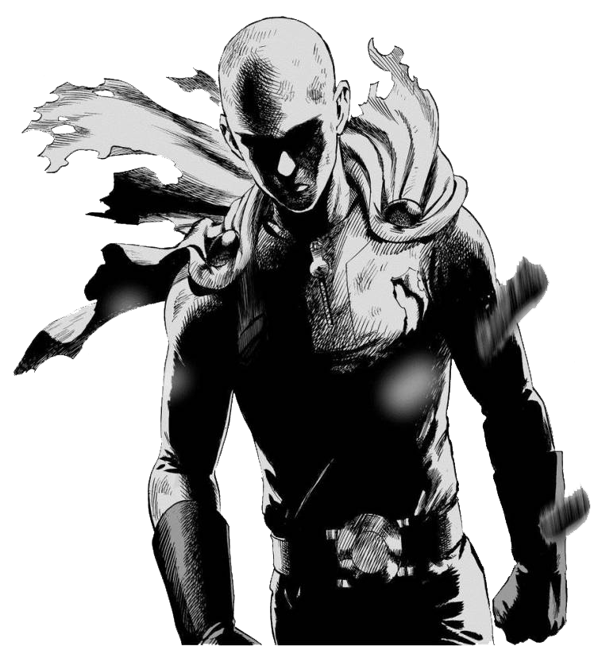
Types of Manga Comics
In the Post-occupational years, particularly between 1950 and 1969, an increasingly large readership for manga was established, leading to the division into two main marketing genres - shōnen, aimed at boys, and shōjo, dedicated to girls. In shōnen, one can find comics that were sub-divided according to age: boys up to 18 years old, young men 18 to 30 years old, known as seinen, and adult, grown men, referred to as seijin manga.
Source Article: Widewalls

Slide 12
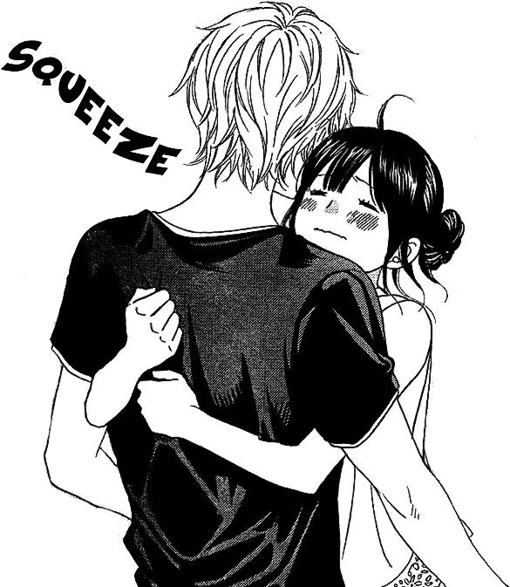
Types of Manga Comics
Charged with action, adventure, fighting of all kinds, as well as sports, technology, romance and sometimes sexuality, these involved one or more male protagonists and helped create the concept of heroes. Shōjo, the “female” comics, were essentially the same way, while their topics and core audience were, of course, female.
Source Article: Widewalls

Slide 13
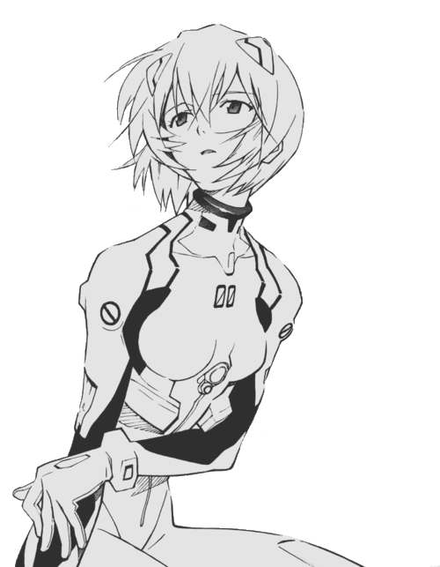
漫画
05
Most Famous
Japanese Manga

Slide 14
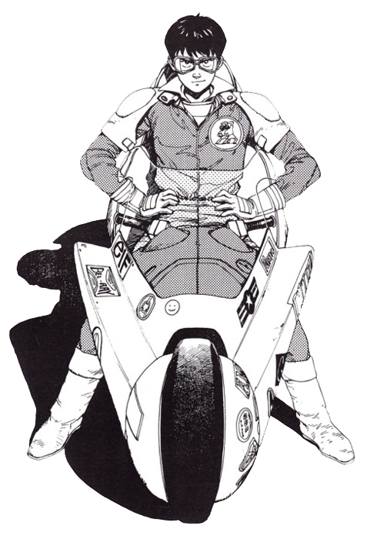
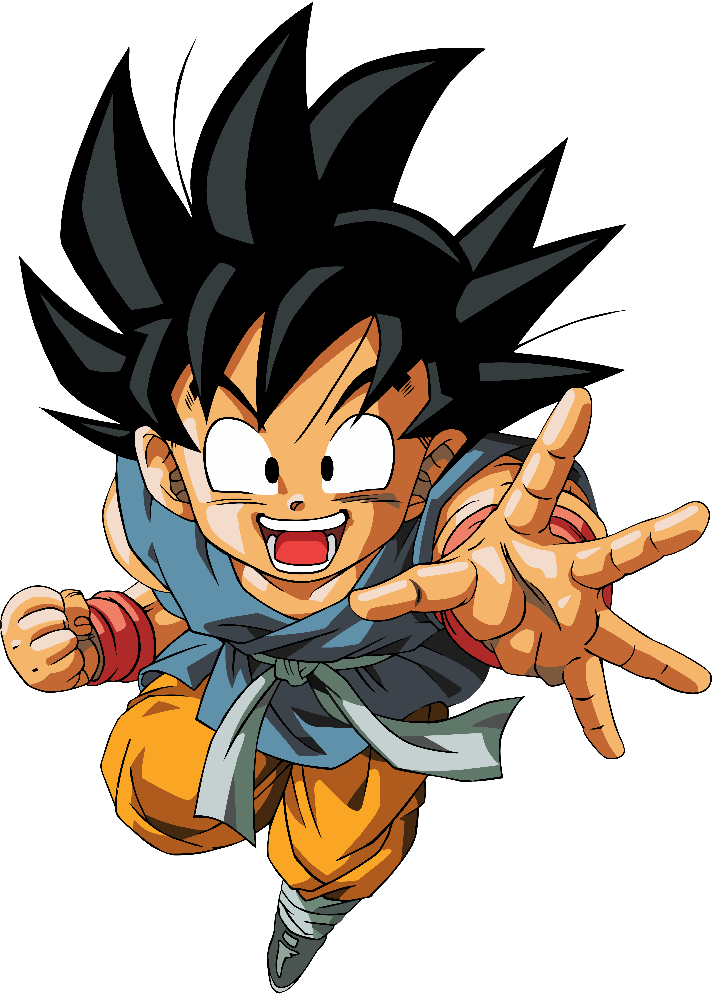
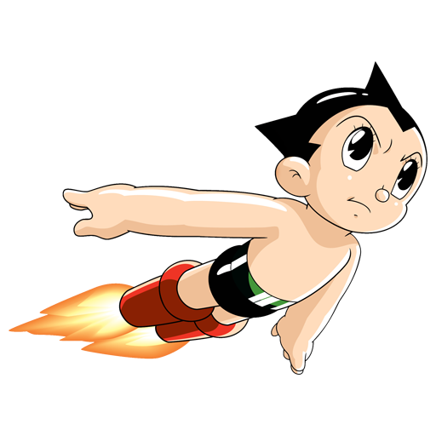
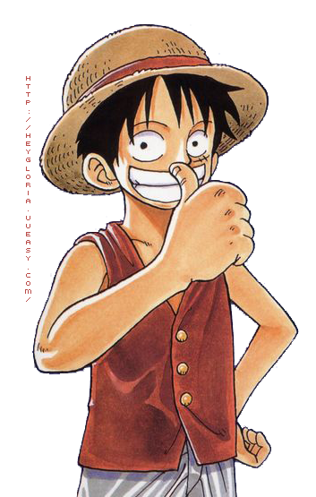

The Most Famous Japanese Manga
While the most popular manga can be determined by the number of copies sold, there are also older examples of comics, particularly those created in the years after the Second Great War that are still renowned as the most iconic examples of the famous Japanese comic. Every fan has its own favorite, that’s for sure – someone prefers those dealing with romance, others prefer sports or business and commerce; everything is up to a reader.
Source Article: Widewalls

Slide 15
Astro Boy
Astro Boy is famous manga series written and illustrated by Osamu Tezuka, and it was published between 1952 and 1968. It’s also known as Mighty Atom. Astro Boy is a science fiction comic set in a futuristic planet where Robots co-exist with humans. The manga has sold approximately 100 million copies, and many anime series and video games were created inspired by the original Astro Boy.
Astro Boy
Source Article: Widewalls

Slide 16
One Piece
One of the best known shonen manga is One Piece. Shonen manga is manga aimed at a young male audience (particularly for boys between 8 and 18). It follows the adventures of Monkey D. Luffy, a young man whose body gained the properties of rubber after unintentionally eating a Devil Fruit. It is written by Eiichiro Oda and the first volume came out in 1997, and it’s still being published. In 2016, the manga has 380 million copies printed worldwide, making it the best-selling manga series in history.
One Piece
Source Article: Widewalls

Slide 17
Dragon Ball
Dragon Ball is a Japanese manga series, written and illustrated by Akira Toriyama. The main character is Son Goku, who trains martial arts and explores the planet in search of the seven orbs known as the Dragon Balls. Manga follows Son Goku’s adventures from his childhood through adulthood. There were 42 volumes of the comic, and it had been published between 1984 and 1995.
Dragon Ball
Source Article: Widewalls

Slide 18
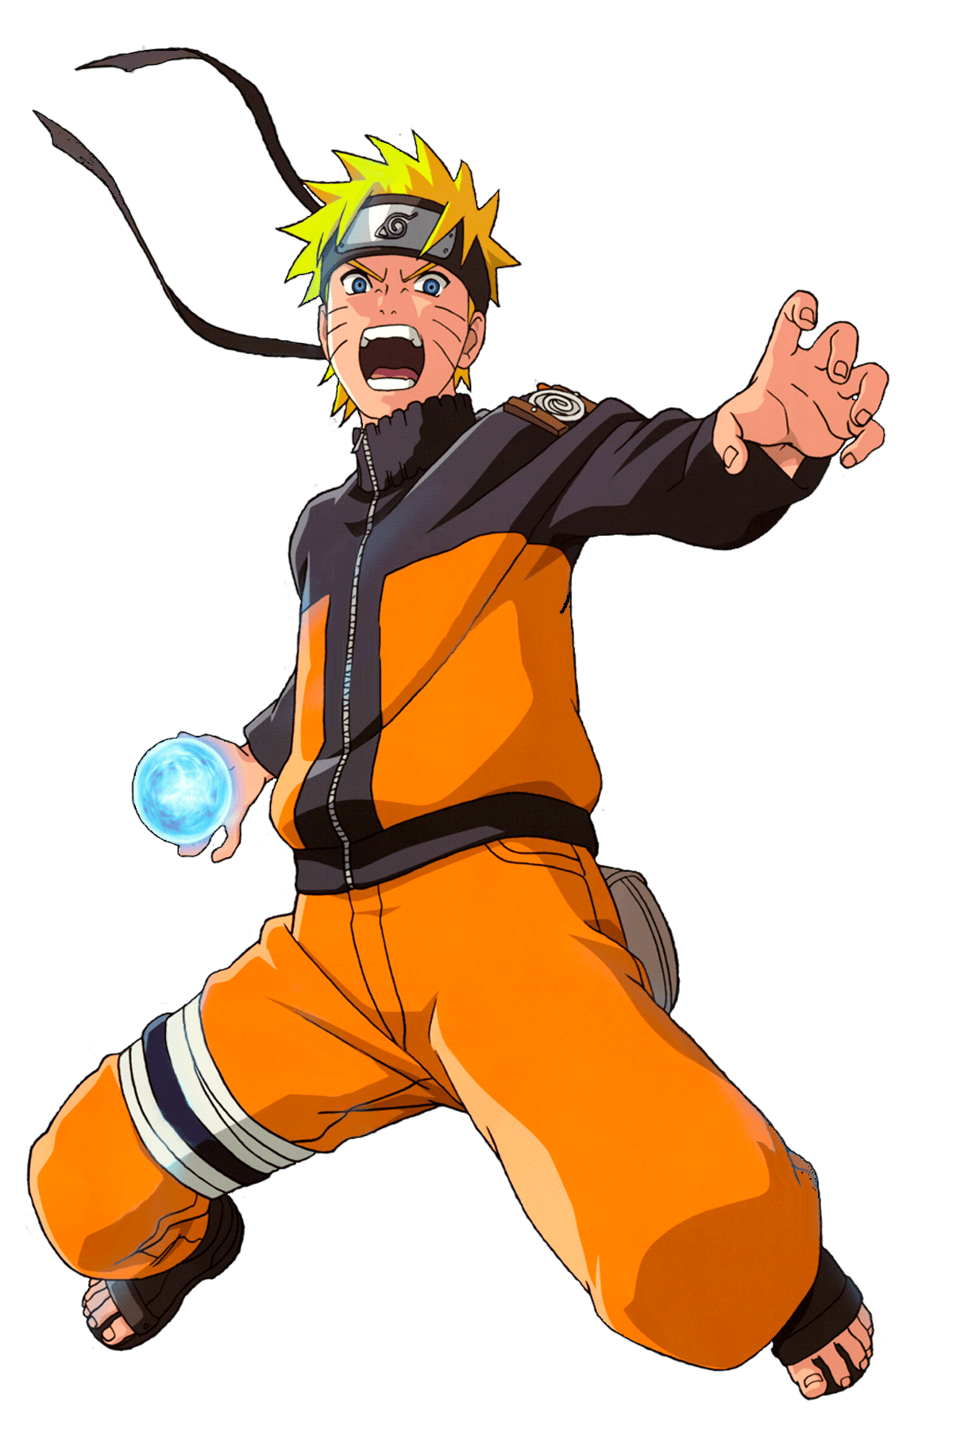
Naruto
Naruto is a Japanese manga series that tells the story of Naruto Uzumaki, an adolescent ninja who constantly searches for recognition and dreams to become the Hokage, the ninja in his village who is acknowledged as the leader and the strongest of all. The series is written and illustrated by Masashi Kishimoto. The first volume came out in 1997 and a vast number of video games were developed based on Naruto manga.
Naruto
Source Article: Widewalls

Slide 19
Detective Conan
Case Closed in an ongoing Japanese detective manga series written and illustrated by Gosho Aoyama. It was originally known as Detective Conan. The first volume was printed in 1994, and the story follows Jimmy Kudo, who is a high school detective who sometimes works with the police to solve cases.
Detective Conan
Source Article: Widewalls

Slide 20
Akira
Akira (アキラ, stylized as AKIRA) is a Japanese cyberpunk manga series written and illustrated by Katsuhiro Otomo. It was serialized biweekly in Kodansha's seinen manga magazine Young Magazine from December 20, 1982, to June 25, 1990, with its 120 chapters collected into six tankōbon volumes. It was published in the United States by Marvel Comics under Epic Comics, becoming one of the first manga ever to be completely translated into English.
Akira
Source Article: Widewalls

Slide 21

Black Jack
Black Jack is a Japanese manga written and illustrated by Osamu Tezuka in the 1970s, dealing with the medical adventures of the title character, doctor Black Jack. The manga consists of short, self-contained stories that are typically about 20 pages long. The main character presents himself as a medical mercenary, selling his skills to whoever will pay his price, while his odd appearance comes from a childhood incident, in which both he and his mother were injured in an explosion.
Black Jack
Source Article: Widewalls

Slide 22
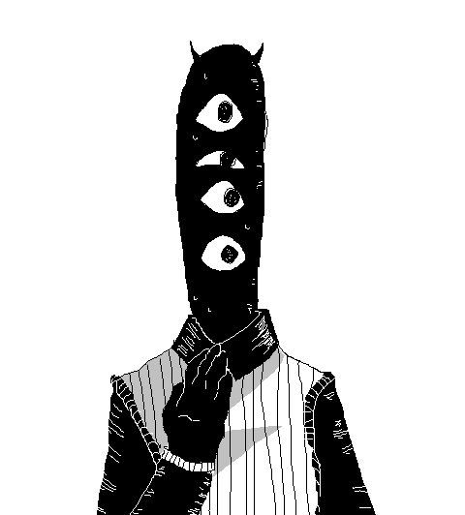
漫画
06
Worldwide expansion
& threats

Slide 23
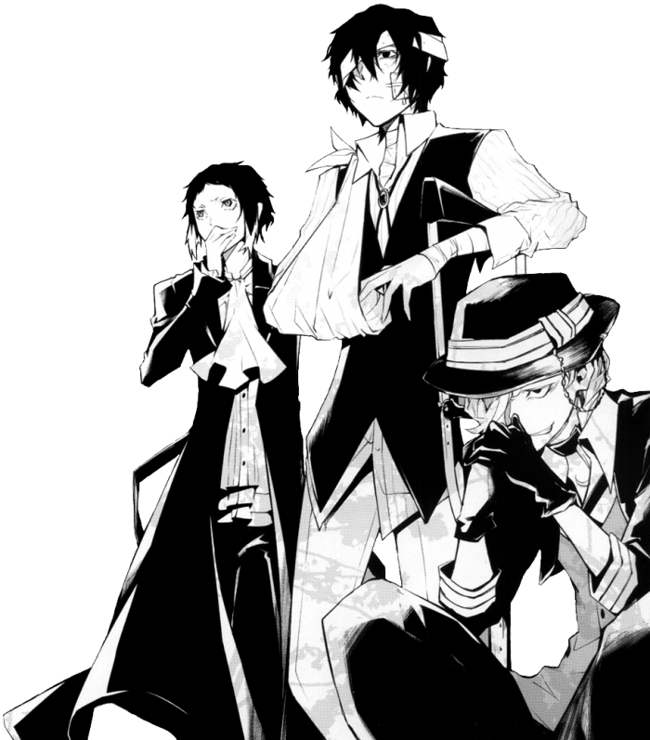
The Worldwide Expansion of Manga
Since the late 1980s, Japanese manga has taken the world by storm. The influence of manga on the comics market has increased significantly in the last two decades, but it had also had an aesthetic effect on comic artists around the globe. Due to the current global development of manga and anime, cultural scholars are suggesting that Japan could be considered as another center of globalization. The influence of manga in the Southeast Asian societies can be ascribed to cultural proximity, but the penetration of manga in Europe and North America is interesting to study.
Source Article: Widewalls

Slide 24
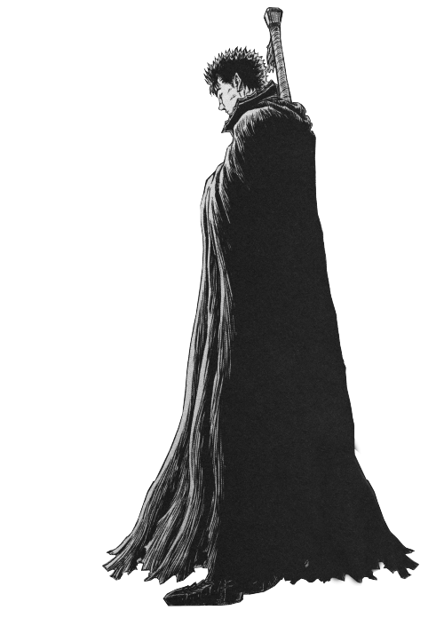
The Worldwide Expansion of Manga
Since written Japanese fiction usually flows from right to left, manga stories are also published to flow from top to bottom and from right to left. While some of the foreign publishers keep this format, the majority mirrors the pages horizontally before printing the translation. In this process known as “flipping”, it is very important to carefully adapt the translation to the flipped artwork so that it follows an image. At first, many manga creators such as Akira Toriyama did not approve of the modification of their work in this way. Still, due to the market expansion and fan demand, the right-to-left formatting has become commonplace abroad.
Source Article: Widewalls

Slide 25
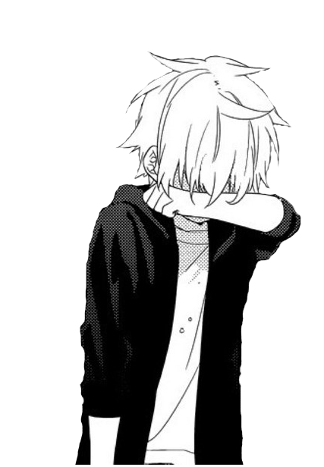
A Threat to the Industry
In recent years, the industry has been suffering acutely due to the piracy. Affecting all media everywhere, Internet piracy is particularly endemic to manga.
Many faithful fans started learning Japanese online, acquiring original publications, and then scanned, translated, edited and uploaded them online. With scanlations appearing sometimes mere hours after a new chapter is released in Japan, the practice is striking at the heart of manga and threatening its very existence. This is making it increasingly difficult for manga artists, or mangaka, to earn a living from their work.
Source Article: Widewalls

Slide 26
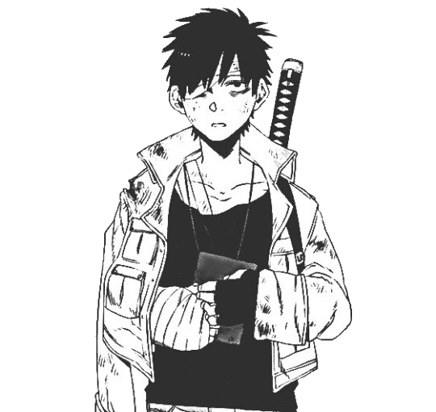
漫画
07
Extra Slides

Slide 27
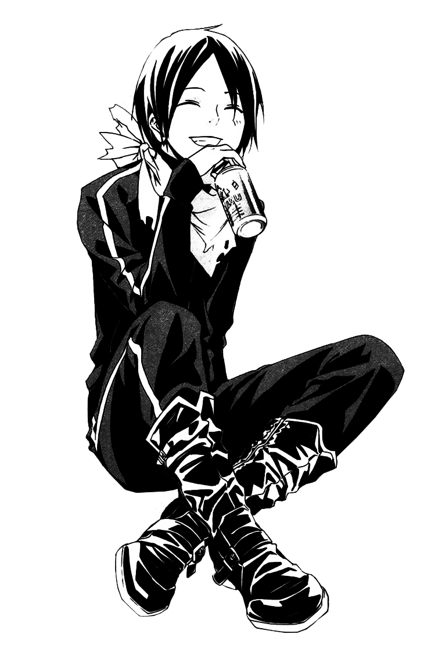
漫画
15 min
Break Time

Slide 28


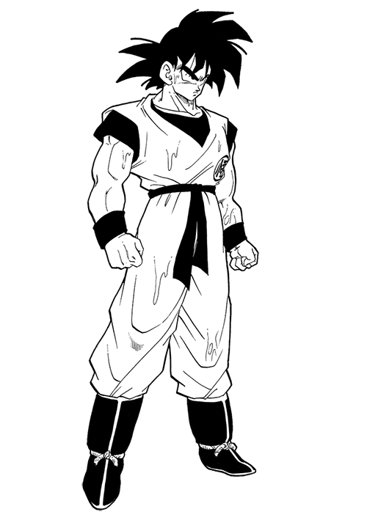
漫画
END
Thank you!

Slide 29
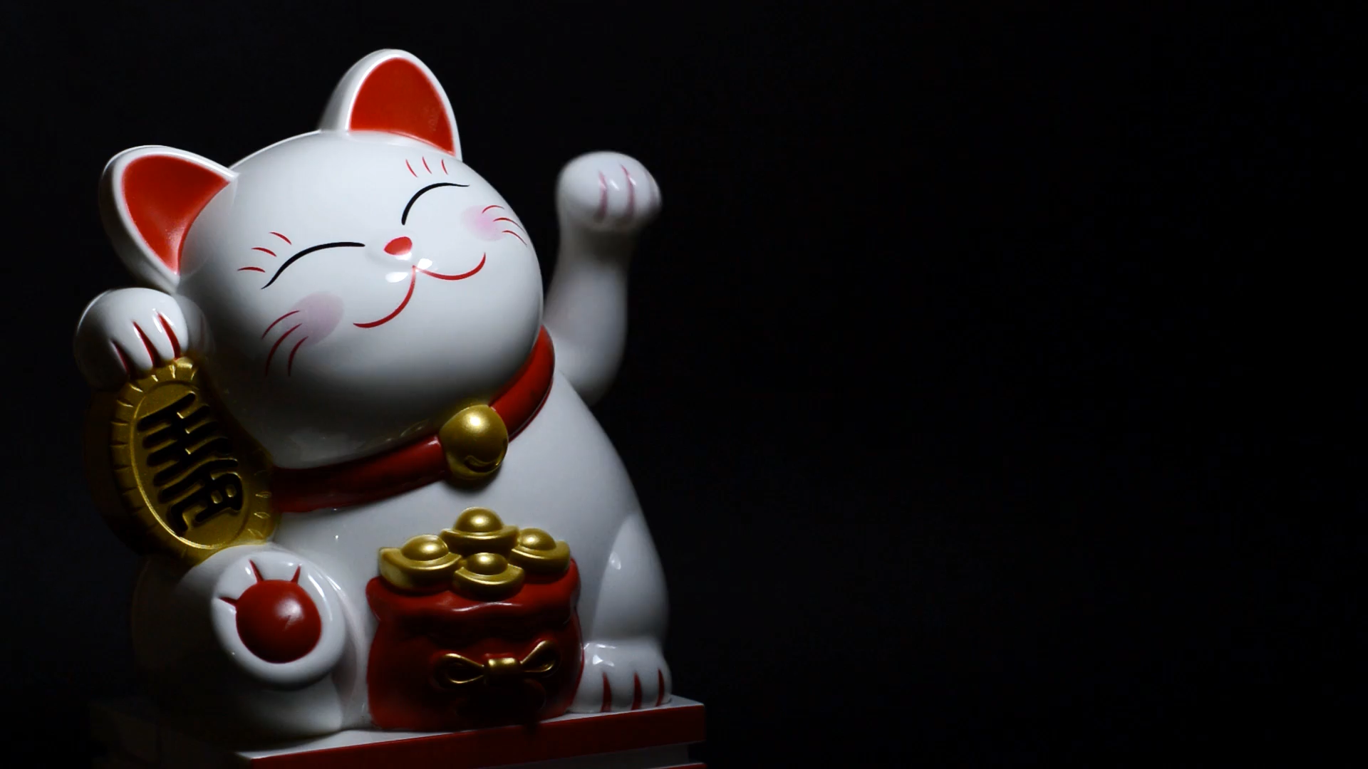
漫画
00
Video Loop
Cover

Slide 30
Editable Icon Set
Things you can do:
Resize the icon
Change fill color and opacity
Add stroke
Add dash lines

Slide 31






www.vnuslide.asia
www.paopoi.xyz
www.gamepowerpoint.online
Kho giao diện mẫu Powerpoint có sẵn hoàn toàn miễn phí và liên tục cập nhật, tải xuống
và sử dụng
Dịch vụ làm thuê slide
giá siêu rẻ chỉ từ 5k/slide,
hiệu ứng chuyên nghiệp,
luôn luôn đúng hạn,
giao cấp tốc trong 24h
Kho game thiết kế trên powerpoint dành cho các buổi thuyết trình, độc đáo, miễn phí, liên tục cập nhật
TRUY CẬP
TRUY CẬP
TRUY CẬP

Slide 32

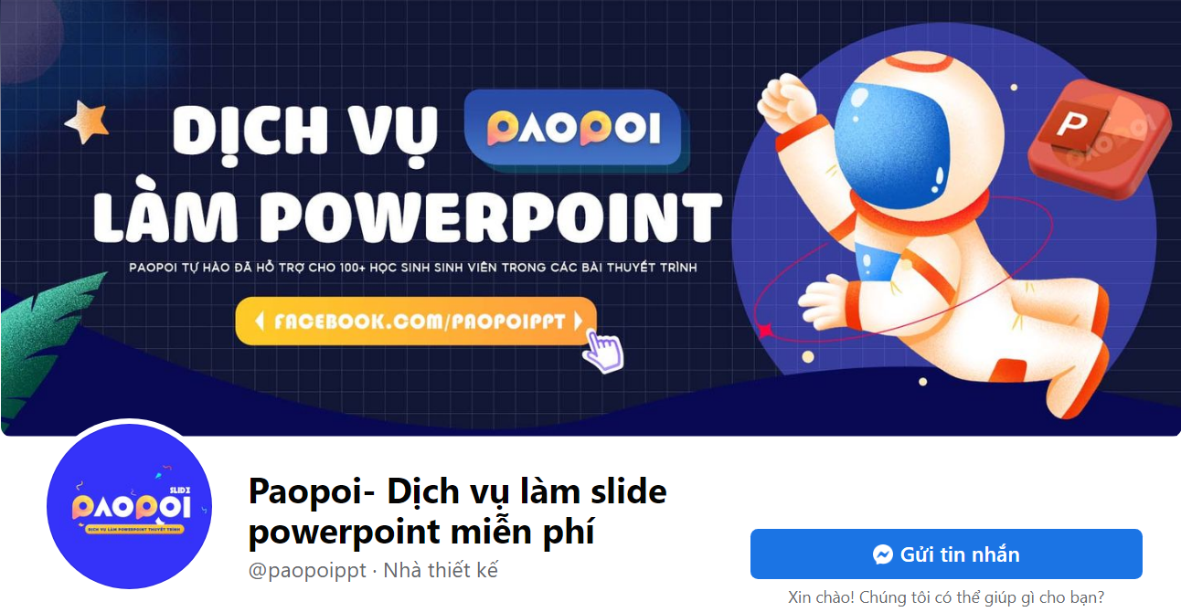

FACEBOOK.COM/PAOPOI.PPT
WWW.PAOPOI.XYZ

